Slide 1
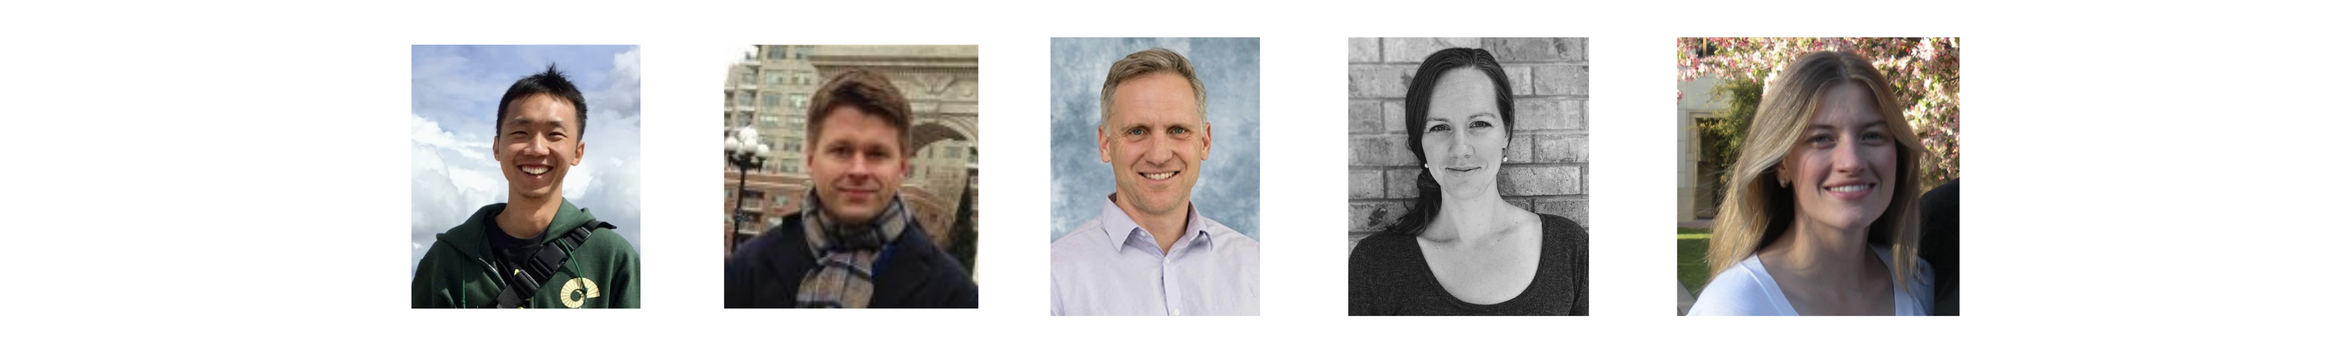
Mapping Large-Scale Climate Variability to Hydrological Extremes: An Application of Linear Inverse Model to Subseasonal Prediction (J. Clim.)
Kai-Chih Tseng^{1,2}, Nat Johnson¹, Eric Maloney³, Elizabeth Barnes³, Sarah Kapnick⁴
1. NOAA, Geophysical Fluid Dynamics Laboratory
2. Program in Atmospheric and Oceanic Sciences, Princeton University
3. Department of Atmospheric Science, Colorado State University
4. J. P. Morgan

Slide 2
Mapping Large-Scale Climate Variability to Hydrological Extremes: An Application of Linear Inverse Model to Subseasonal Prediction (J. Clim.)
Kai-Chih Tseng^{1,2}, Nat Johnson¹, Eric Maloney³, Elizabeth Barnes³, Sarah Kapnick⁴
1. NOAA, Geophysical Fluid Dynamics Laboratory
2. Program in Atmospheric and Oceanic Sciences, Princeton University
3. Department of Atmospheric Science, Colorado State University
4. J. P. Morgan

Slide 3
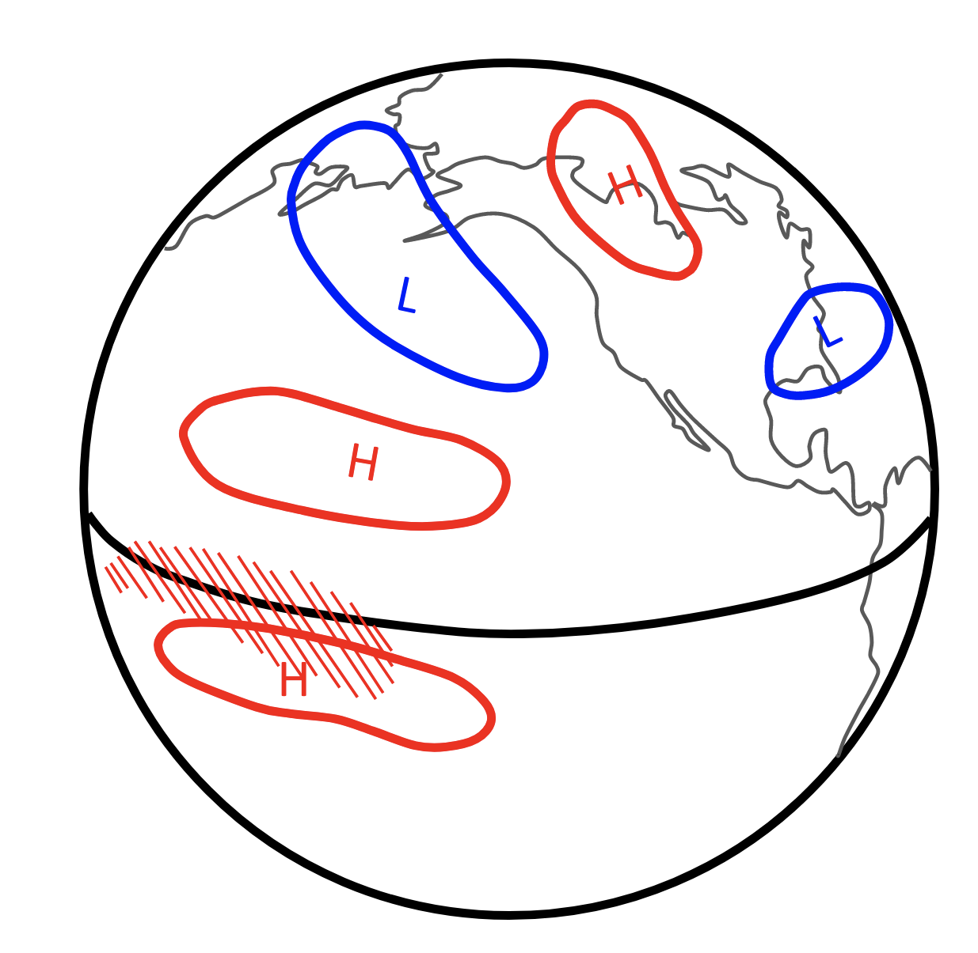
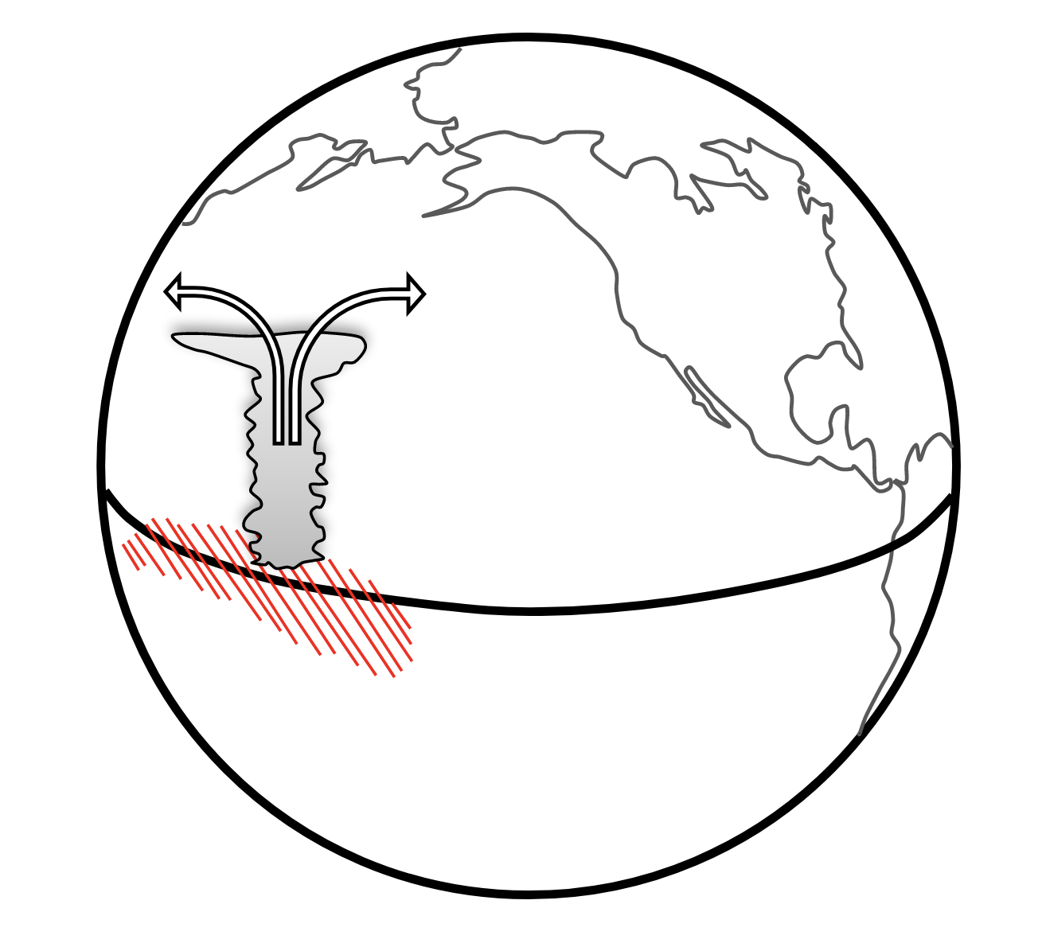
Motivation:

Slide 4

Motivation:

Slide 5
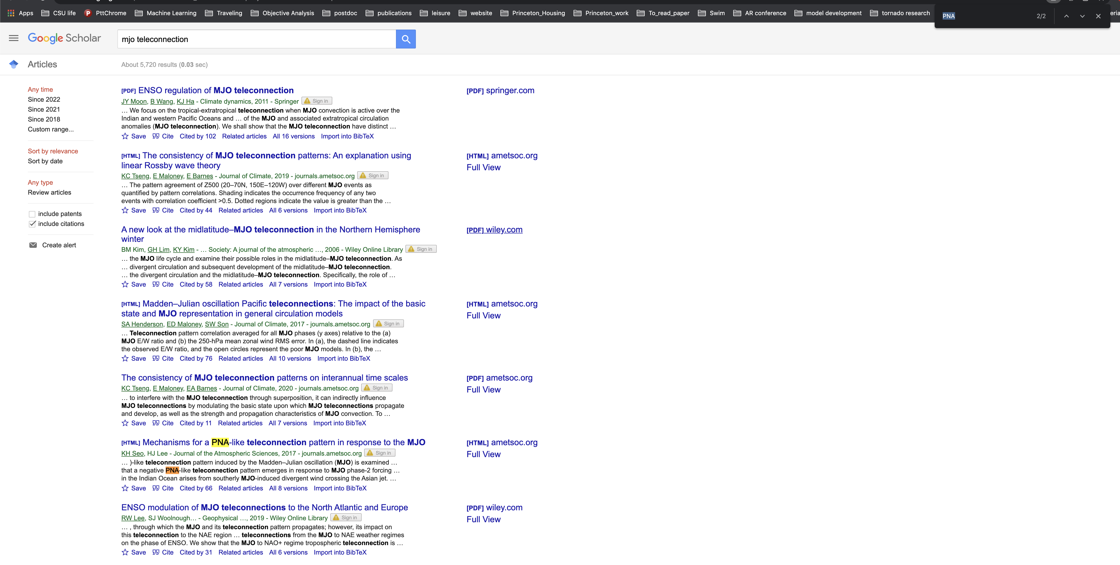
Motivation:
Most of the key words are PNA or associated with PNA

Slide 6
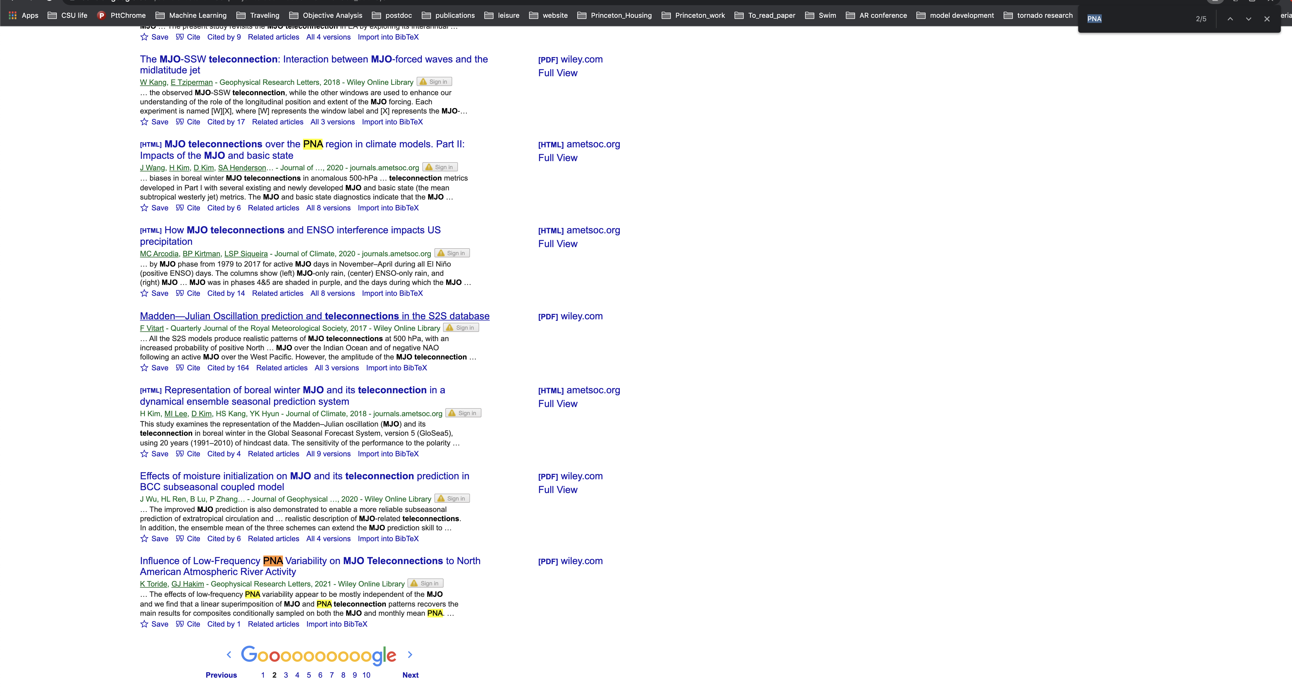
Motivation:
Most of the key words are PNA or associated with PNA

Slide 7
Motivation:
Where are other extratropical modes?

Slide 8
To probe this question…
Linear Inverse Model

Slide 9
Part I: Model Setup
Part II: Results

Slide 10
Part I: Model Setup
Part II: Results

Slide 11
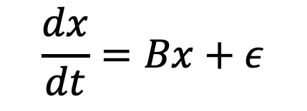
So…what is a linear inverse model?
$$\frac{dx}{dt}=Bx+ε$$

Slide 12
So…what is a linear inverse model?
$$\frac{dx}{dt}=Bx+ε$$
Const
White noise

Slide 13
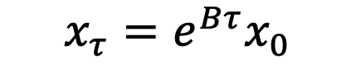
So…what is a linear inverse model?
$$\frac{dx}{dt}=Bx+ε$$
$$x_{τ}=e^{Bτ}x_{0}$$
Const
White noise

Slide 14
So…what is a linear inverse model?
$$\frac{dx}{dt}=Bx+ε$$
$$x_{τ}=e^{Bτ}x_{0}$$
Const
White noise
Final States
Initial States

Slide 15
So…what is a linear inverse model?
Autoregressive model
(or lag regression model)
$$\frac{dx}{dt}=Bx+ε$$
$$x_{τ}=e^{Bτ}x_{0}$$
Growth Rate & Frequency

Slide 16
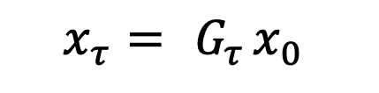
So…what is a linear inverse model?
Autoregressive model
(or lag regression model)
$$\frac{dx}{dt}=Bx+ε$$
$$x_{τ}={ G}_{τ}x_{0}$$
Growth Rate & Frequency

Slide 17
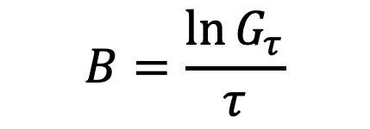
So…what is a linear inverse model?
Autoregressive model
(or lag regression model)
$$\frac{dx}{dt}=Bx+ε$$
$$x_{τ}={ G}_{τ}x_{0}$$
Growth Rate & Frequency
$$B=\frac{\ln{G_{τ}}}{τ}$$

Slide 18
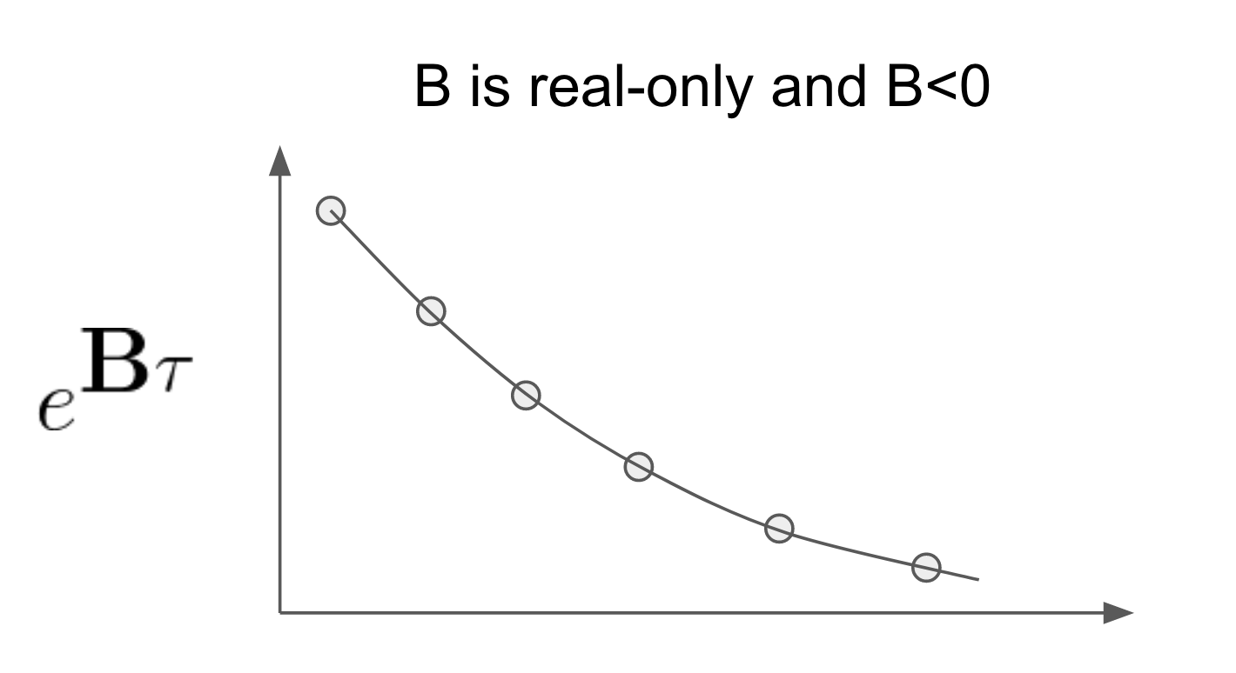
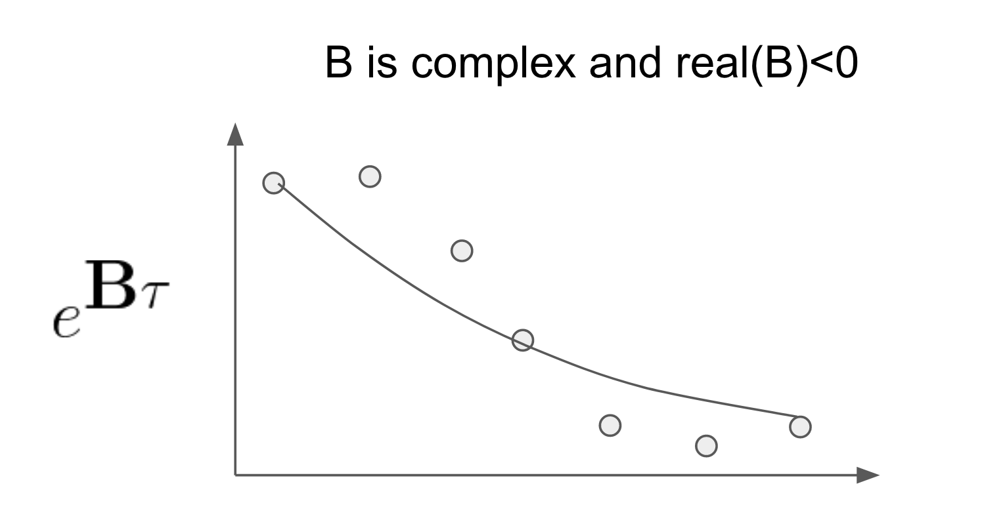
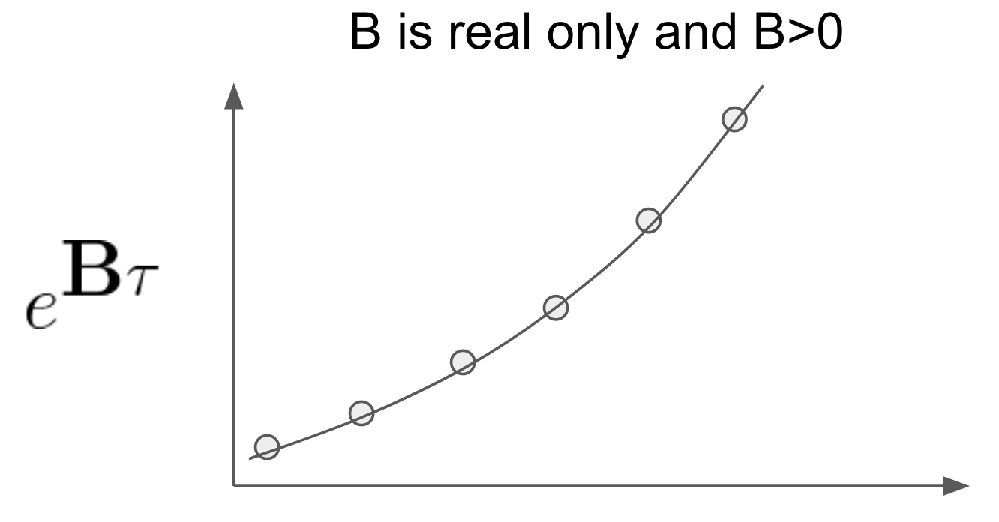
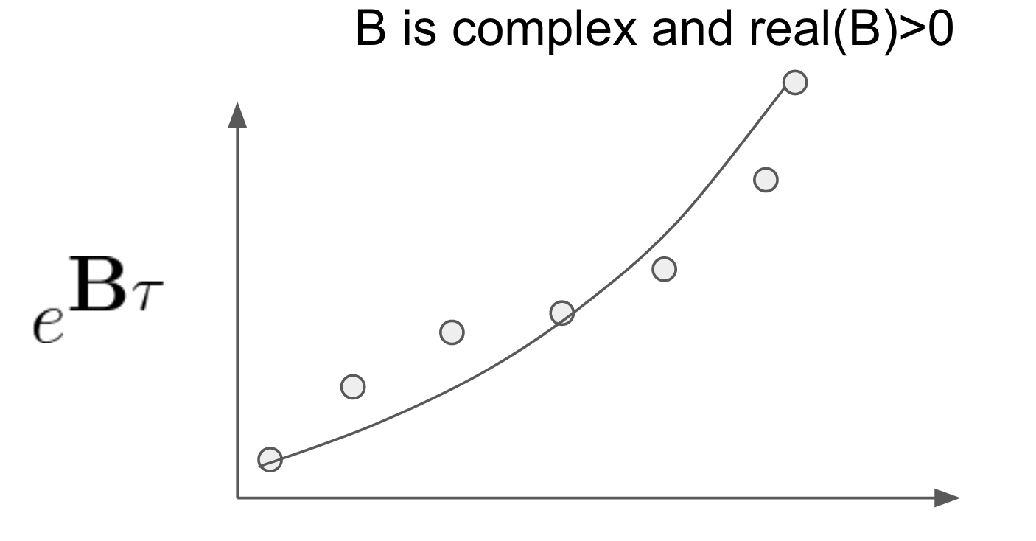
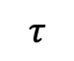
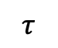
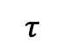
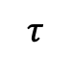
The meaning of B
$$τ$$
$$τ$$
$$τ$$
$$τ$$

Slide 19
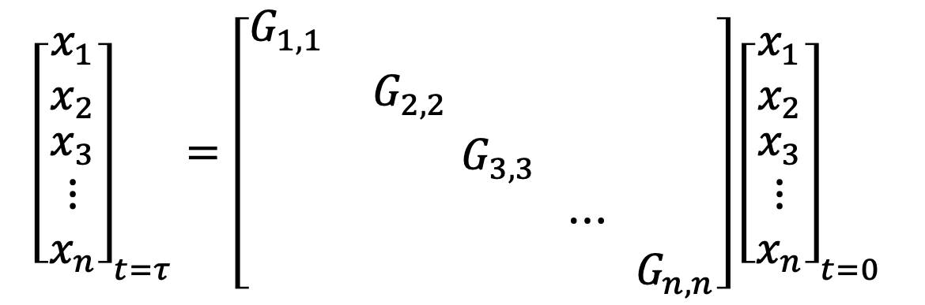
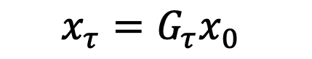
Now, let’s go to higher dimensions…
$$x_{τ}=G_{τ}x_{0}$$
$${\left[\begin{matrix}x_{1} \\ x_{2} \\ \begin{matrix}x_{3} \\ ⋮ \\ x_{n}\end{matrix}\end{matrix}\right]}_{t=τ}=\left[\begin{matrix}G_{1,1} & \begin{matrix} & \begin{matrix} & \end{matrix} & \end{matrix} \\ \begin{matrix} \\ \begin{matrix} \\ \end{matrix} \\ \end{matrix} & \begin{matrix}\begin{matrix}G_{2,2} & \begin{matrix} & \end{matrix} & \end{matrix} \\ \begin{matrix}\begin{matrix} \\ \end{matrix} & \begin{matrix}\begin{matrix}G_{3,3} & \end{matrix} \\ \begin{matrix} & ⋯\end{matrix}\end{matrix} & \begin{matrix} \\ \end{matrix}\end{matrix} \\ \begin{matrix} & \begin{matrix} & \end{matrix} & G_{n,n}\end{matrix}\end{matrix}\end{matrix}\right]{\left[\begin{matrix}x_{1} \\ x_{2} \\ \begin{matrix}x_{3} \\ ⋮ \\ x_{n}\end{matrix}\end{matrix}\right]}_{t=0}$$
Diagonal elements represent the memory of each variable

Slide 20
Now, let’s go to higher dimensions…
$$x_{τ}=G_{τ}x_{0}$$
$${\left[\begin{matrix}x_{1} \\ x_{2} \\ \begin{matrix}x_{3} \\ ⋮ \\ x_{n}\end{matrix}\end{matrix}\right]}_{t=τ}=\left[\begin{matrix}G_{1,1} & \begin{matrix} & \begin{matrix} & \end{matrix} & \end{matrix} \\ \begin{matrix} \\ \begin{matrix} \\ \end{matrix} \\ \end{matrix} & \begin{matrix}\begin{matrix}G_{2,2} & \begin{matrix} & \end{matrix} & \end{matrix} \\ \begin{matrix}\begin{matrix} \\ \end{matrix} & \begin{matrix}\begin{matrix}G_{3,3} & \end{matrix} \\ \begin{matrix} & ⋯\end{matrix}\end{matrix} & \begin{matrix} \\ \end{matrix}\end{matrix} \\ \begin{matrix} & \begin{matrix} & \end{matrix} & G_{n,n}\end{matrix}\end{matrix}\end{matrix}\right]{\left[\begin{matrix}x_{1} \\ x_{2} \\ \begin{matrix}x_{3} \\ ⋮ \\ x_{n}\end{matrix}\end{matrix}\right]}_{t=0}$$
Different Scales
Diagonal elements represent the memory of each variable

Slide 21
Now, let’s go to higher dimensions…
$$x_{τ}=G_{τ}x_{0}$$
$${\left[\begin{matrix}x_{1} \\ x_{2} \\ \begin{matrix}x_{3} \\ ⋮ \\ x_{n}\end{matrix}\end{matrix}\right]}_{t=τ}=\left[\begin{matrix}G_{1,1} & \begin{matrix} & \begin{matrix} & \end{matrix} & \end{matrix} \\ \begin{matrix} \\ \begin{matrix} \\ \end{matrix} \\ \end{matrix} & \begin{matrix}\begin{matrix}G_{2,2} & \begin{matrix} & \end{matrix} & \end{matrix} \\ \begin{matrix}\begin{matrix} \\ \end{matrix} & \begin{matrix}\begin{matrix}G_{3,3} & \end{matrix} \\ \begin{matrix} & ⋯\end{matrix}\end{matrix} & \begin{matrix} \\ \end{matrix}\end{matrix} \\ \begin{matrix} & \begin{matrix} & \end{matrix} & G_{n,n}\end{matrix}\end{matrix}\end{matrix}\right]{\left[\begin{matrix}x_{1} \\ x_{2} \\ \begin{matrix}x_{3} \\ ⋮ \\ x_{n}\end{matrix}\end{matrix}\right]}_{t=0}$$
Different Variables
Diagonal elements represent the memory of each variable

Slide 22
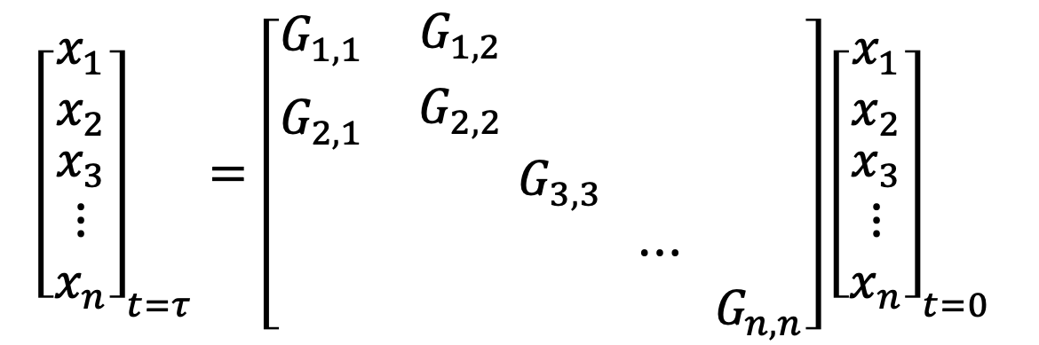
Now, let’s go to higher dimensions…
$$x_{τ}=G_{τ}x_{0}$$
$${\left[\begin{matrix}x_{1} \\ x_{2} \\ \begin{matrix}x_{3} \\ ⋮ \\ x_{n}\end{matrix}\end{matrix}\right]}_{t=τ}=\left[\begin{matrix}G_{1,1} & \begin{matrix}G_{1,2} & \begin{matrix} & \end{matrix} & \end{matrix} \\ \begin{matrix}G_{2,1} \\ \begin{matrix} \\ \end{matrix} \\ \end{matrix} & \begin{matrix}\begin{matrix}G_{2,2} & \begin{matrix} & \end{matrix} & \end{matrix} \\ \begin{matrix}\begin{matrix} \\ \end{matrix} & \begin{matrix}\begin{matrix}G_{3,3} & \end{matrix} \\ \begin{matrix} & ⋯\end{matrix}\end{matrix} & \begin{matrix} \\ \end{matrix}\end{matrix} \\ \begin{matrix} & \begin{matrix} & \end{matrix} & G_{n,n}\end{matrix}\end{matrix}\end{matrix}\right]{\left[\begin{matrix}x_{1} \\ x_{2} \\ \begin{matrix}x_{3} \\ ⋮ \\ x_{n}\end{matrix}\end{matrix}\right]}_{t=0}$$
Off-diagonal elements represent the interaction between 2 variables

Slide 23
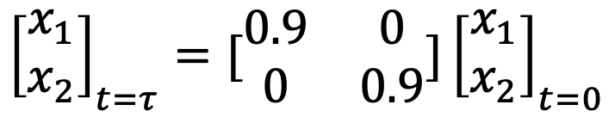
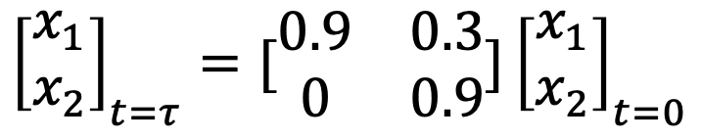
So…why off-diagonal elements are important?
Modal
Nonmodal
$${\left[\begin{matrix}x_{1} \\ x_{2}\end{matrix}\right]}_{t=τ}=[\begin{matrix}0.9 & 0 \\ 0 & 0.9\end{matrix}]{\left[\begin{matrix}x_{1} \\ x_{2}\end{matrix}\right]}_{t=0}$$
$${\left[\begin{matrix}x_{1} \\ x_{2}\end{matrix}\right]}_{t=τ}=[\begin{matrix}0.9 & 0.3 \\ 0 & 0.9\end{matrix}]{\left[\begin{matrix}x_{1} \\ x_{2}\end{matrix}\right]}_{t=0}$$
Source Code https://github.com/kuiper2000/kuiper2000.github.io/blob/master/conference/AMS_LIM.ipynb

Slide 24
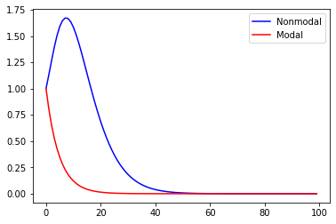
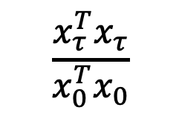
So…why off-diagonal elements are important?
Modal
Nonmodal
$${\left[\begin{matrix}x_{1} \\ x_{2}\end{matrix}\right]}_{t=τ}=[\begin{matrix}0.9 & 0 \\ 0 & 0.9\end{matrix}]{\left[\begin{matrix}x_{1} \\ x_{2}\end{matrix}\right]}_{t=0}$$
$${\left[\begin{matrix}x_{1} \\ x_{2}\end{matrix}\right]}_{t=τ}=[\begin{matrix}0.9 & 0.3 \\ 0 & 0.9\end{matrix}]{\left[\begin{matrix}x_{1} \\ x_{2}\end{matrix}\right]}_{t=0}$$
$$\frac{x_{τ}^{T}x_{τ}}{x_{0}^{T}x_{0}}$$
Ratio of variance between the initial and final states
Time steps
Source Code https://github.com/kuiper2000/kuiper2000.github.io/blob/master/conference/AMS_LIM.ipynb

Slide 25
So…why off-diagonal elements are important?
Because it represent interaction between two variables.
When the interaction is not symmetric, the system is nonmodal and can favor short-term growth of the energy.
Source Code https://github.com/kuiper2000/kuiper2000.github.io/blob/master/conference/AMS_LIM.ipynb

Slide 26
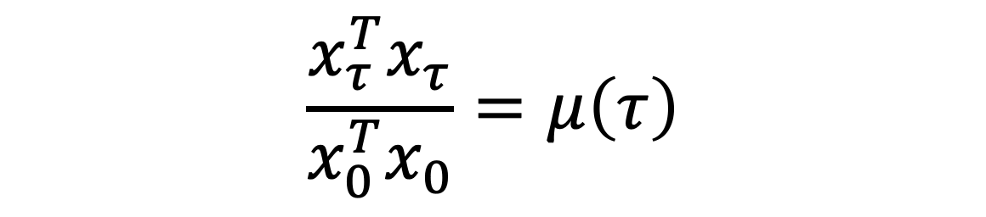
To derive the optimal initial pattern
$$\frac{x_{τ}^{T}x_{τ}}{x_{0}^{T}x_{0}}=μ\left(τ\right)$$
Ratio of variance between the initial and final states

Slide 27
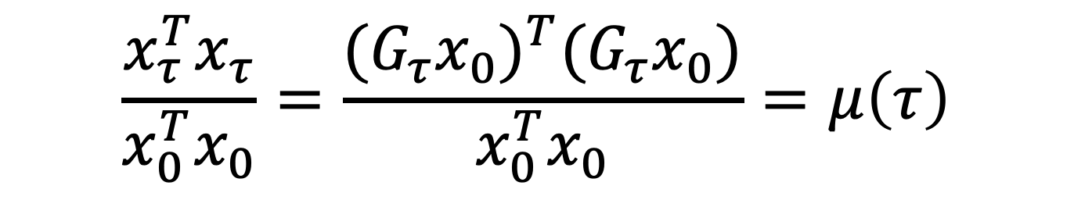
To derive the optimal initial pattern
$$\frac{x_{τ}^{T}x_{τ}}{x_{0}^{T}x_{0}}=\frac{{({G_{τ}x}_{0})}^{T}({G_{τ}x}_{0})}{x_{0}^{T}x_{0}}=μ\left(τ\right)$$

Slide 28
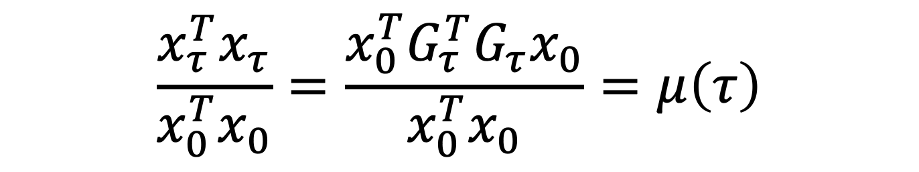
To derive the optimal initial pattern
$$\frac{x_{τ}^{T}x_{τ}}{x_{0}^{T}x_{0}}=\frac{x_{0}^{T}G_{τ}^{T}{G_{τ}x}_{0}}{x_{0}^{T}x_{0}}=μ\left(τ\right)$$

Slide 29
To derive the optimal initial pattern
$$\frac{x_{τ}^{T}x_{τ}}{x_{0}^{T}x_{0}}=\frac{x_{0}^{T}G_{τ}^{T}{G_{τ}x}_{0}}{x_{0}^{T}x_{0}}=μ\left(τ\right)$$
$$G_{τ}^{T}{G_{τ}x}_{0}=μ\left(τ\right)x_{0}$$
The eigen vector which can give us the biggest eigen value is so-called optimal pattern (maximize the growth of signals).

Slide 30
To derive the optimal initial pattern
$$\frac{x_{τ}^{T}x_{τ}}{x_{0}^{T}x_{0}}=\frac{x_{0}^{T}G_{τ}^{T}{G_{τ}x}_{0}}{x_{0}^{T}x_{0}}=μ\left(τ\right)$$
We can force the final pattern to be a certain pattern.
$$G_{τ}^{T}{G_{τ}x}_{0}=μ\left(τ\right)x_{0}$$

Slide 31
Part I: Model Setup
Part II: Results

Slide 32
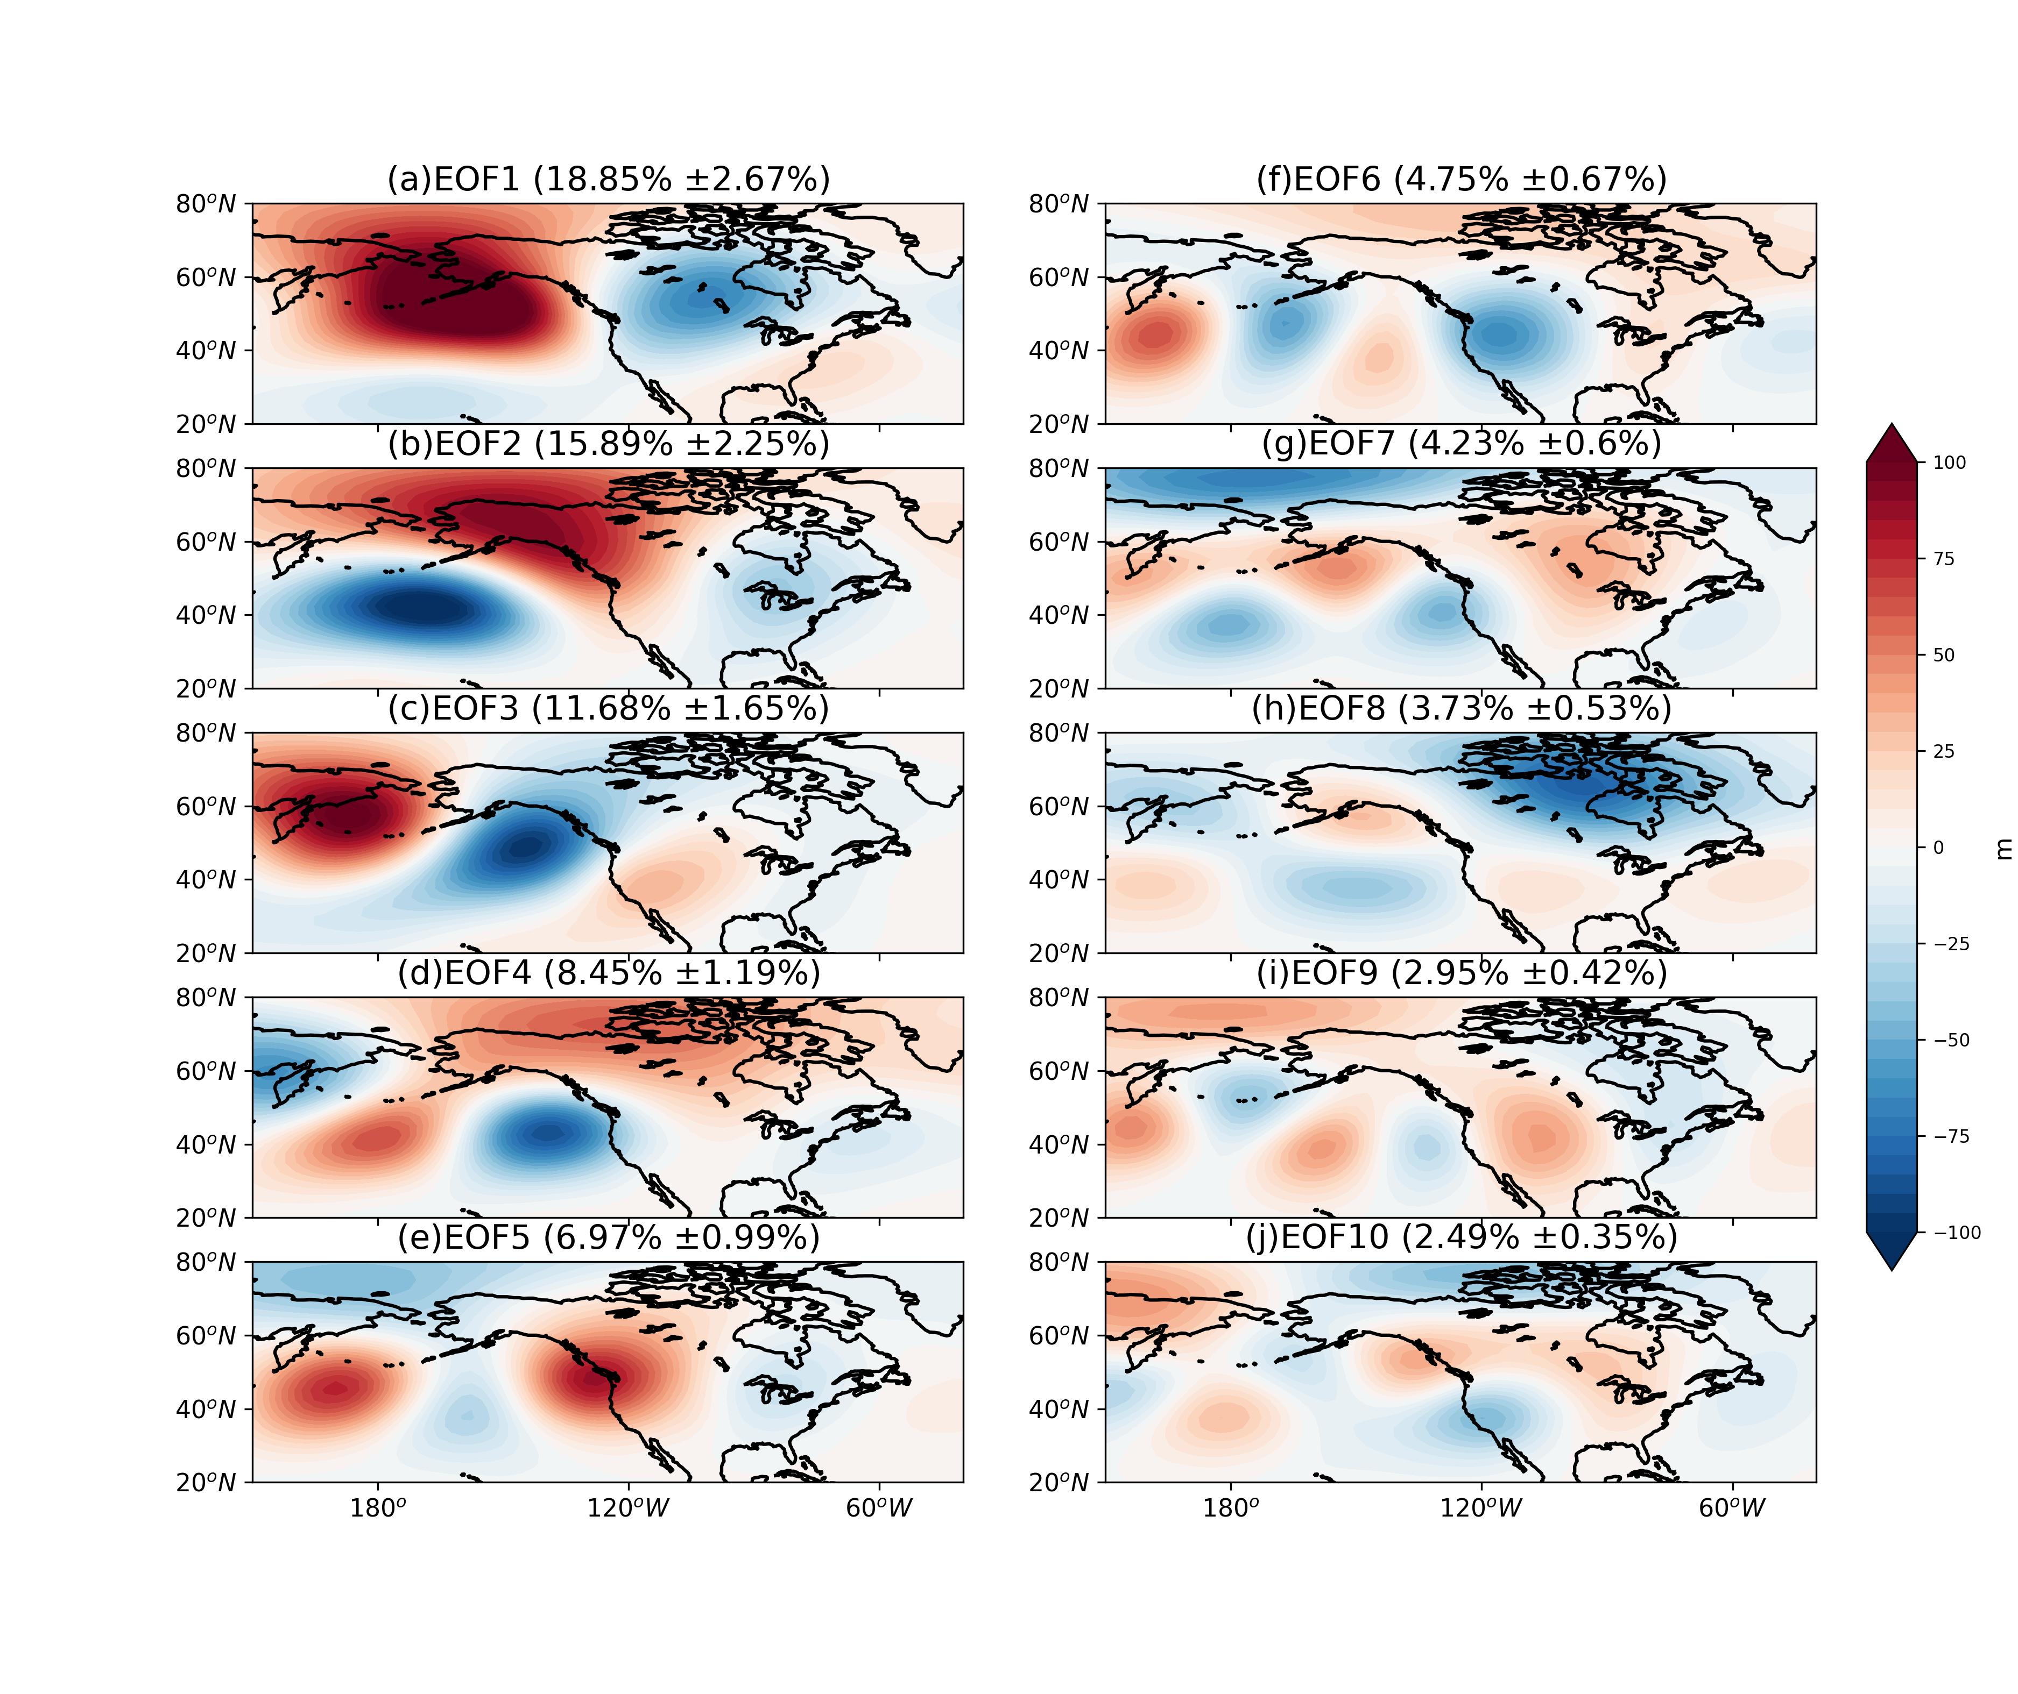
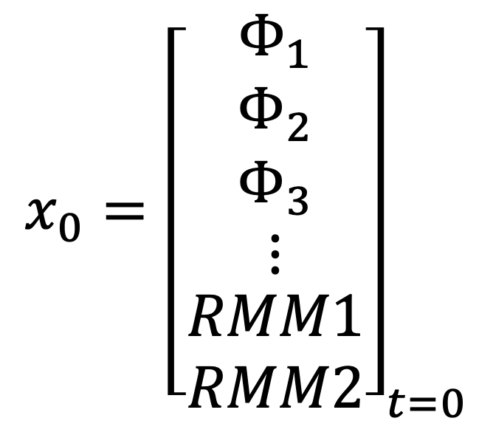
NPO-WP
$$x_{0}={\left[\begin{matrix}Φ_{1} \\ Φ_{2} \\ \begin{matrix}Φ_{3} \\ ⋮ \\ \begin{matrix}RMM1 \\ RMM2\end{matrix}\end{matrix}\end{matrix}\right]}_{t=0}$$
PNA
(DATA: ERA-Interim)

Slide 33
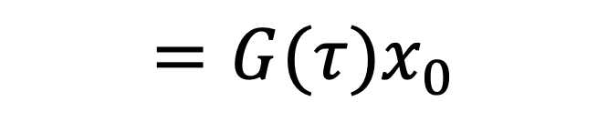
NPO-WP
PNA
$${=G(τ)x}_{0}$$

Slide 34
NPO-WP
PNA
$${=G(τ)x}_{0}$$
What is the optimal initial pattern favoring the growth of different extratropical modes?

Slide 35
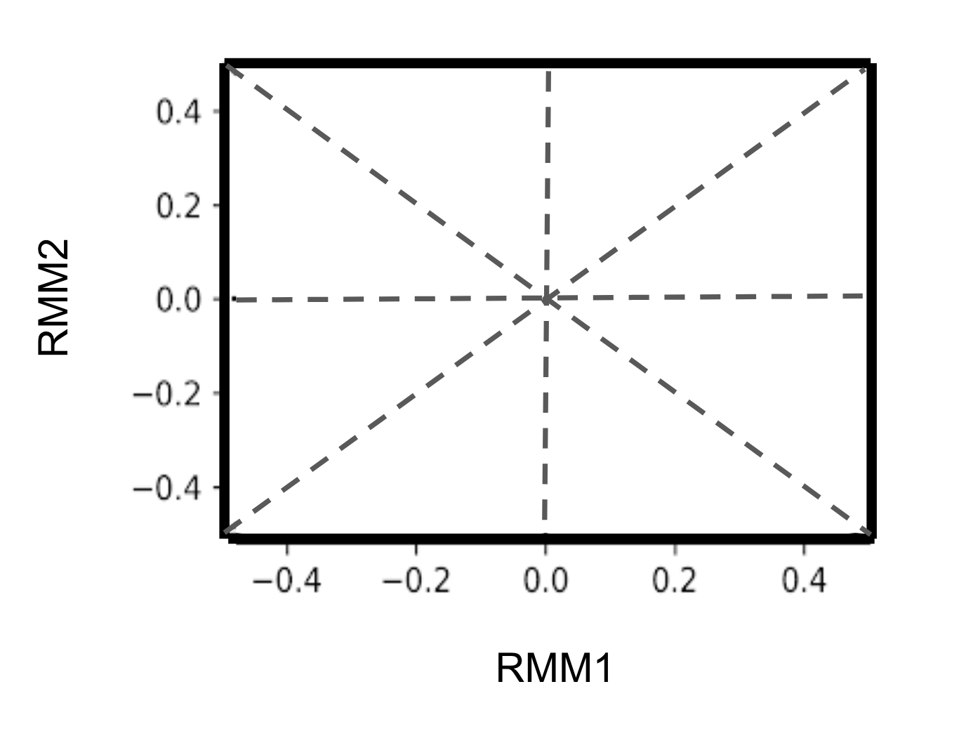

Slide 36
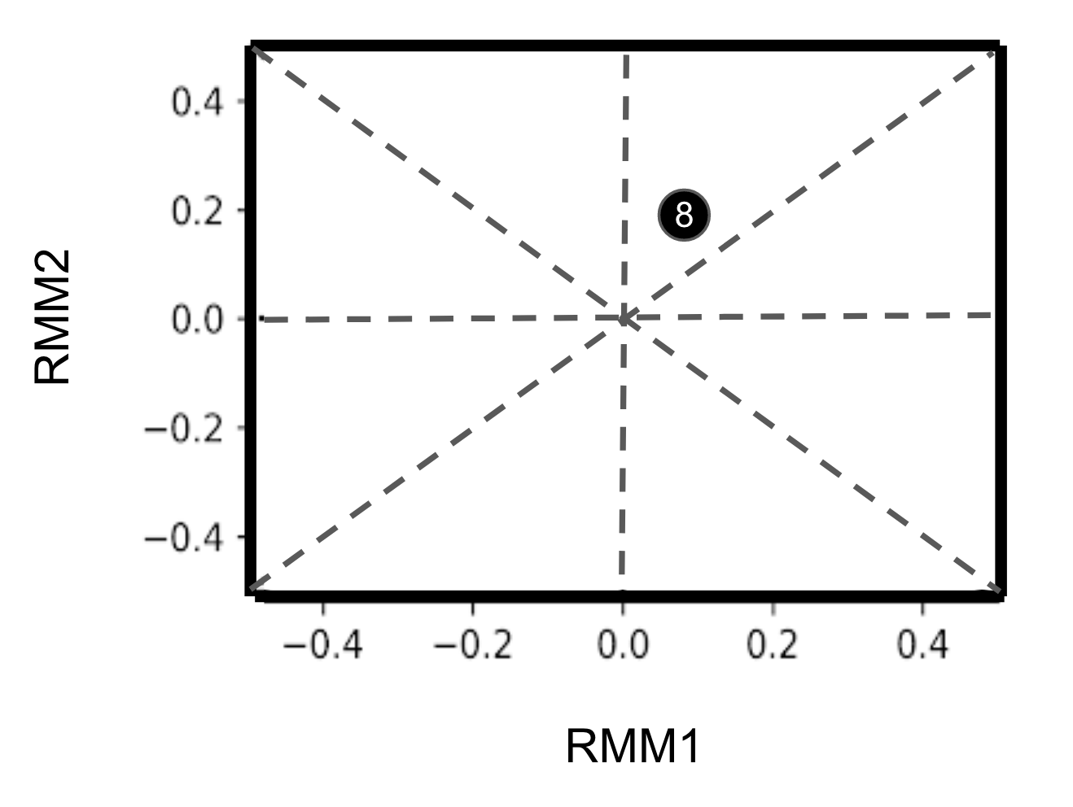

Slide 37
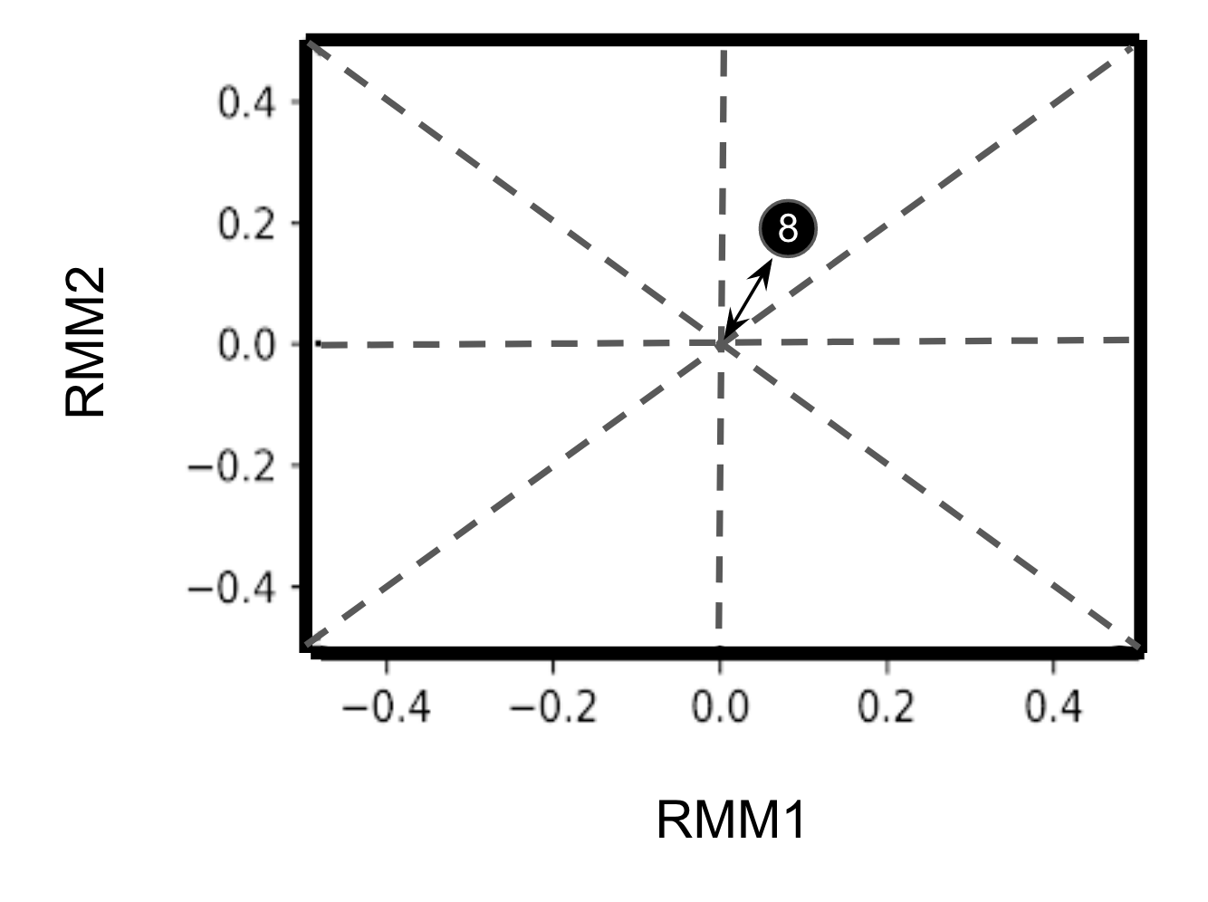

Slide 38
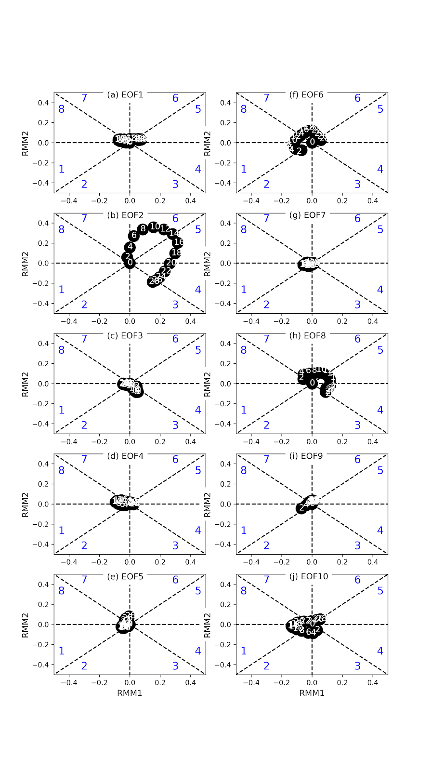
EOF1
EOF2
EOF3
EOF4
EOF5
EOF6
EOF7
EOF8
EOF9
EOF10
EOF2 (PNA) is the mode strongly driven by MJO forcing

Slide 39
Questions:
With the conclusion above, maybe we can hypothesize that the subseasonal forecasts of extreme events mostly benefit from MJO-PNA teleconnection?

Slide 40
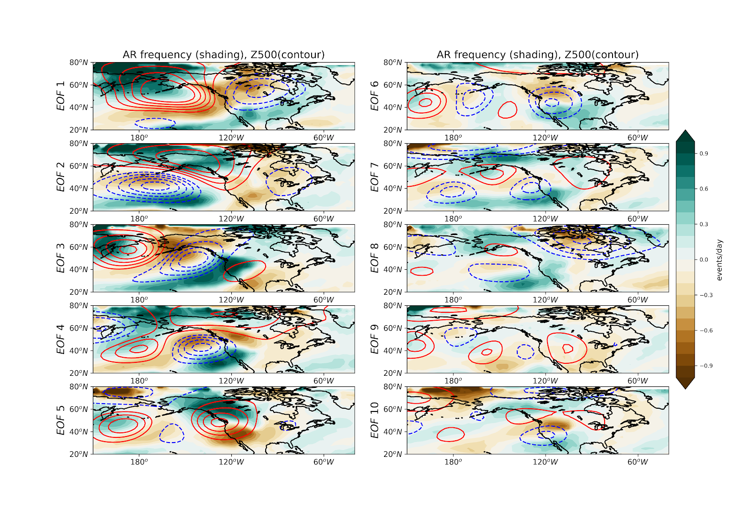
Regressed atmospheric rivers frequency with Z500

Slide 41
Using LIM to predict Z500
Using Z500 to predict hydrological extremes

Slide 42
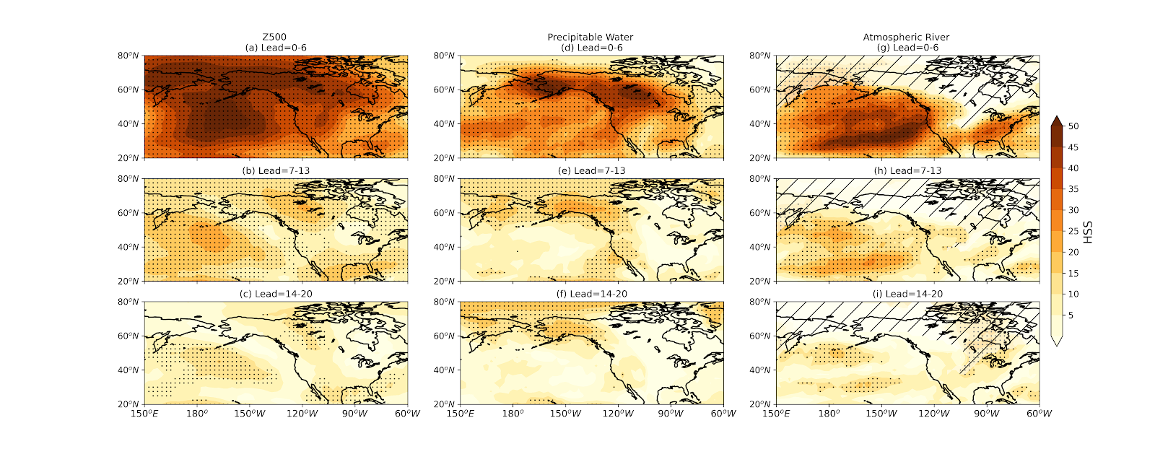
Week 1
Week 2
Week 3

Slide 43
Week 1
Week 2
Week 3

Slide 44
Week 1
Week 2
Week 3
The regions showing the significant prediction skills are the PNA regions.

Slide 45
Week 1
Week 2
Week 3
The regions showing the significant prediction skills in AR are regions influenced by PNA.

Slide 46
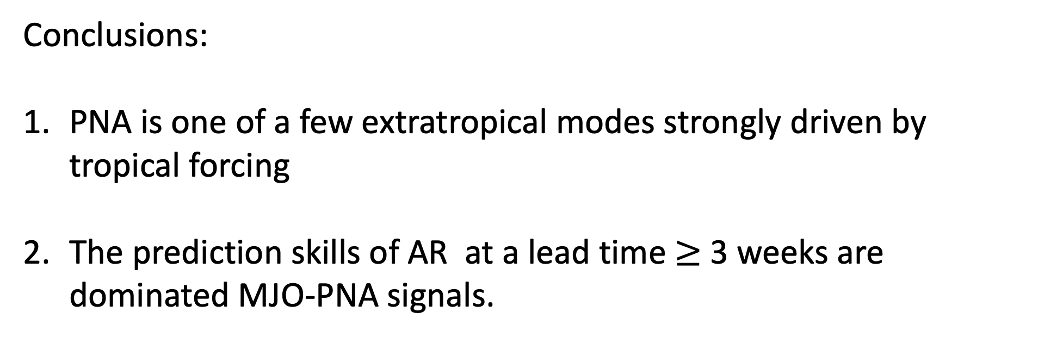
Conclusions:
PNA is one of a few extratropical modes strongly driven by tropical forcing
The prediction skills of AR at a lead time $≥$ 3 weeks are dominated MJO-PNA signals.

Slide 47
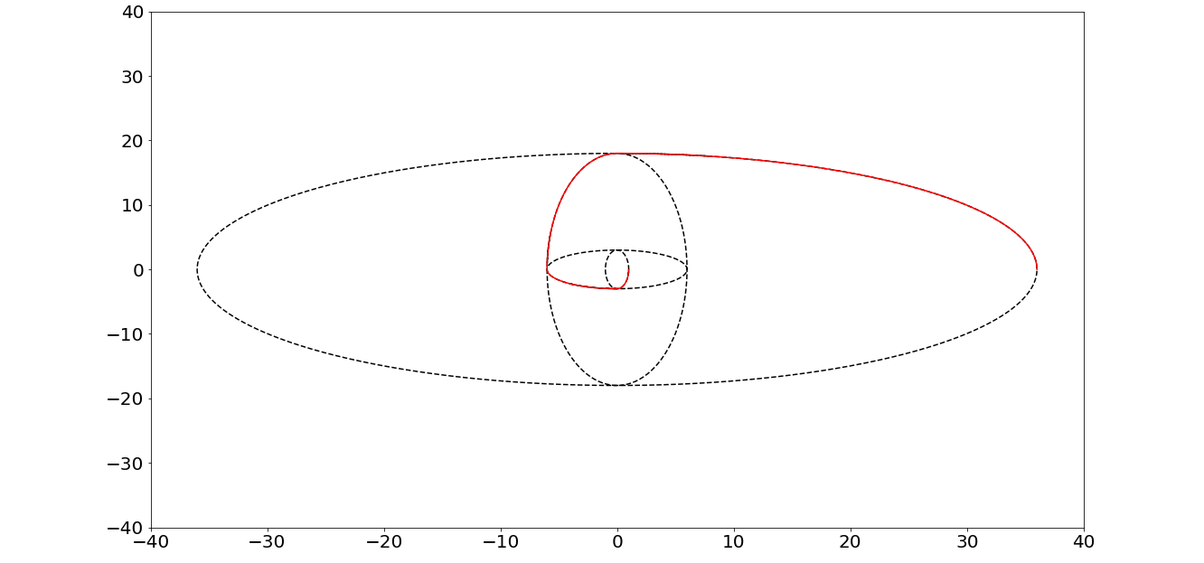
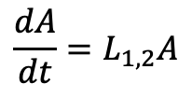
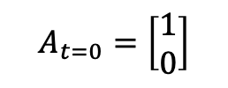
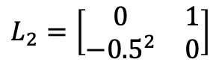
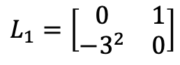
Caveats
Time-dependent basic states (nonlinearity) are important
$$\frac{dA}{dt}=L_{1,2}A$$
L2
$$L_{1}=\left[\begin{matrix}0 & 1 \\ −3^{2} & 0\end{matrix}\right]$$
L1
$$L_{2}=\left[\begin{matrix}0 & 1 \\ −{0.5}^{2} & 0\end{matrix}\right]$$
L1
L2
$$A_{t=0}=\left[\begin{matrix}1 \\ 0\end{matrix}\right]$$
Source Code https://github.com/kuiper2000/kuiper2000.github.io/blob/master/conference/AMS_LIM.ipynb

Slide 48
Caveats
Time-dependent basic states (nonlinearity) are important
Missing physical processes such as SST and stratospheric dynamics.
Slides and Source Code
https://github.com/kuiper2000/kuiper2000.github.io/blob/master/conference

